Slide 1


TELECOM CUSTOMERS CHURN ANALYSIS
- PRESENTED BY -
Pavan Ahire

Slide 2

INDEX
1.Color Theory / Color Palette
2. Business Objective
3. Approach To Prove The Business Insights
4. Data Preparation
5. Key Visuals
6. Dashboard
7. Link to the Dashboard
8. Conclusion

Slide 3
.
COLOR PALETTE
.
.
Pink color represent the Female ratio
.
Blue color represent the Male ratio
.
Cyan color represent the Graphs
Yellow color represent the Paperless Billing Graphs
Red color represent the Data Labels of Graph

Slide 4
BUSINESS OBJECTIVE
In today’s competitive telecom market, customer retention has become a major challenge.
Many customers are discontinuing their services due to factors like high monthly charges, limited support, poor internet service experience, or short-term contracts.
Churn refers to the percentage of customers who stop using a company’s services within a given period.
The company is facing a significant churn rate of 27%, which directly impacts revenue and long-term growth.
However, the organization currently lacks a clear understanding of which customer segments are most likely to churn, and what key factors influence this decision.
Therefore, it is essential to analyze customer data and uncover patterns that explain why customers are leaving and how to reduce churn in the future.

Slide 5
APPROACH TO PROVE THE BUSINESS OBJECTIVE
Identify churn patterns among different customer segments such as gender, senior citizens, and contract types.
Analyze relationships between churn and key factors like monthly charges, tenure, and internet service type.
Compare churn behavior across different services and payment methods.
Measure churn rate and its impact on revenue to understand financial implications.
Provide insights and recommendations that can help improve customer satisfaction and loyalty.

Slide 6
DATA PREPARATION
Dataset Used :
Telecom Customer Churn Data (7,042 records, 21 columns)
Steps Taken
Imported the dataset into Power BI.
Removed duplicates and handled missing values (mainly in TotalCharges).
Converted data types – e.g., SeniorCitizen (0/1 → Yes/No).
Created new columns like:
Tenure (in months )
Number of Services
% of Partners, Dependents, Senior Citizens

Slide 7
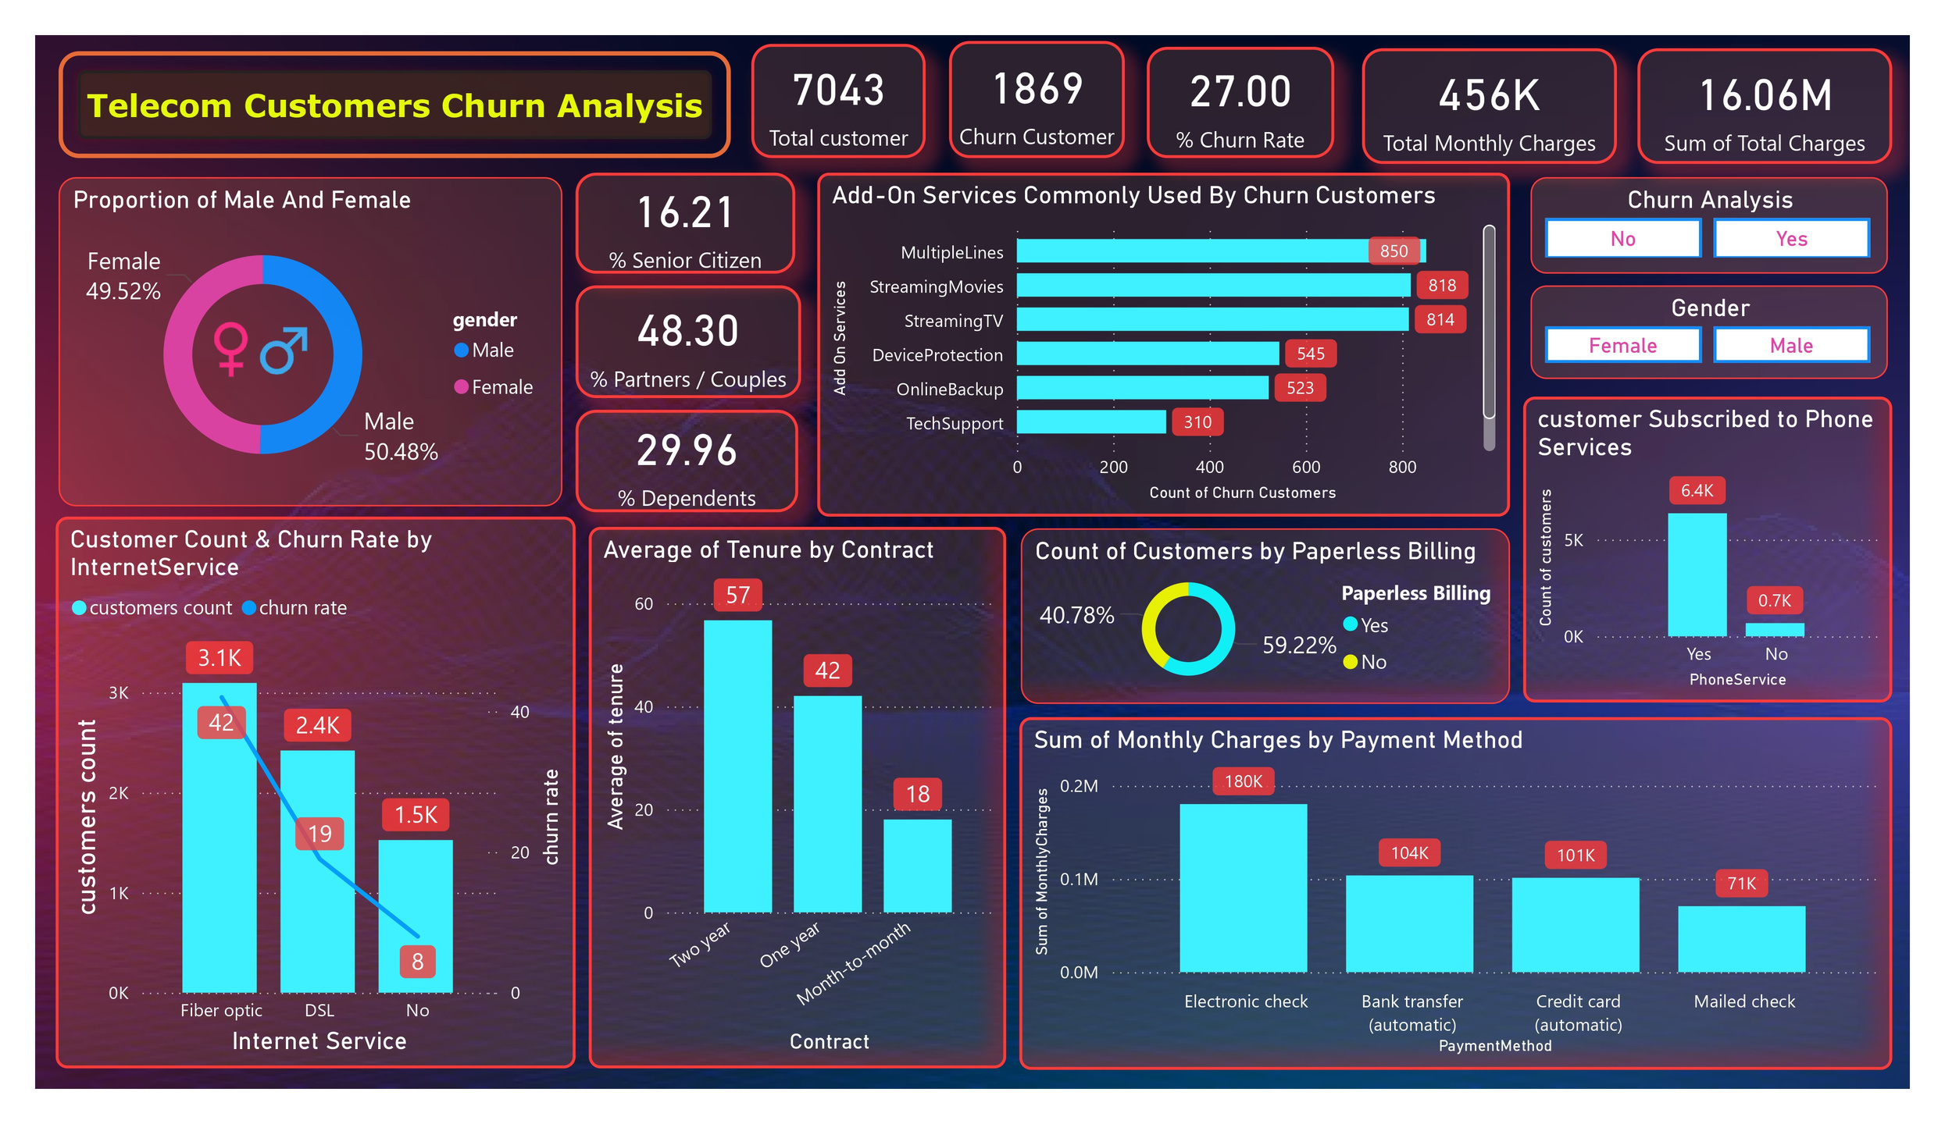

KEY VISUALS
The chart shows an almost equal split — 50.48% male and 49.52% female customers.
This means gender has minimal impact on customer churn in this dataset.
male and female customers face similar service experiences and challenges.
Most customers have subscribed to phone services, showing strong service adoption.
The chart gives a clear visual comparison between users with and without phone service.
It helps identify that churn is influenced by other factors, not just phone service availability.

Slide 8
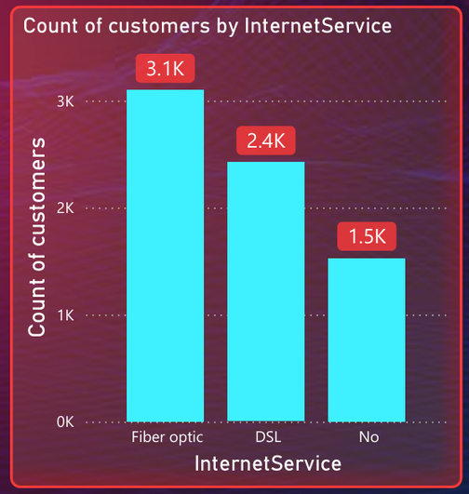
KEY VISUALS
Multiple Lines, Streaming Movies, and Streaming TV are the most common add-on services among churned customers.
A large number of customers who churned were using entertainment-related services, suggesting these may not strongly retain customers.
Services like Tech Support and Online Backup have fewer churned users, possibly because customers using these services feel more supported and loyal.
Fiber Optic is the most used service with 3.1K customers, indicating high demand or availability.
DSL serves 2.4K customers, showing moderate adoption compared to Fiber Optic.
1.5K customers have no internet service, representing a potential upsell opportunity.

Slide 9
KEY VISUALS
Two-year contracts have the highest average tenure (57 months), showing stronger long-term retention.
One-year contracts show moderate loyalty with an average tenure of 42 months.
Month-to-month customers stay the least, averaging only 18 months, indicating higher churn risk.
Electronic Check customers contribute the highest monthly charges 180K, indicating strong usage of this payment method.
Automatic payment methods (Bank Transfer and Credit Card) together account for a major share of total revenue 205K, showing a clear preference for convenience.
Mailed Check shows the lowest monthly charges 71K, highlighting it as the least popular payment option among customers.

Slide 10
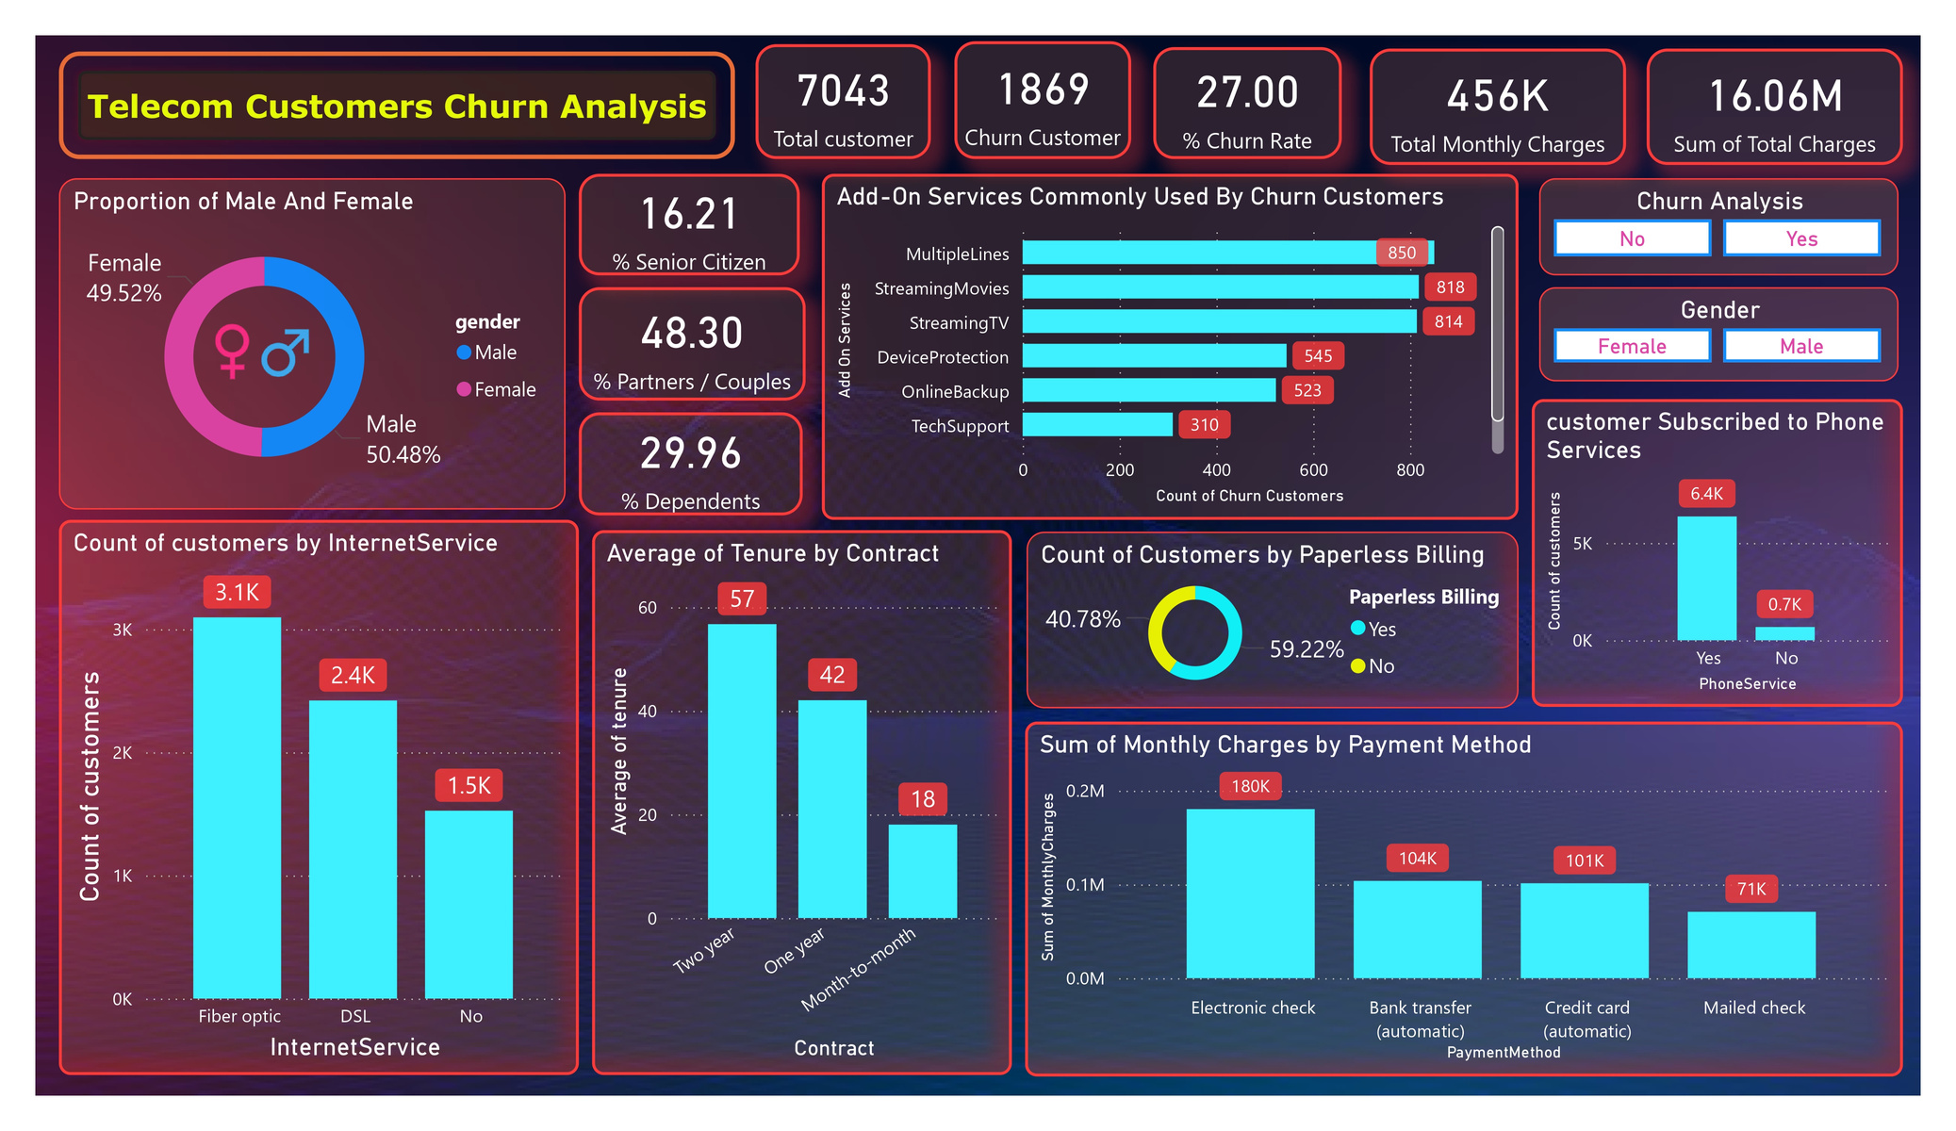
DASHBOARD

Slide 11

Link To The Dashboard
click here

Slide 12
CONCLUSION
The Telecom Customer Churn Analysis indicates that customer retention is a key business concern. The study shows higher churn among customers with month-to-month contracts, higher monthly charges, and those using fiber optic internet services.
Insights:
Churn rate is significantly higher for short-term contract customers.
Customers with higher monthly charges tend to discontinue services.
Fiber optic users show higher churn compared to DSL or no-internet users.
Senior citizens and customers without dependents are more likely to churn.
Recommendations:
Introduce loyalty benefits and targeted retention offers for at-risk customers.
Provide better service quality and technical support for fiber users.
Encourage customers to switch to long-term contracts through attractive incentives.
Develop personalized plans to enhance customer satisfaction and reduce churn.

Slide 13



THANK YOU
CONNECT WITH ME ON
www.linkedin.com/in/pavan-ahire-260940364
https://github.com/pavan-ahire

